Slide 1
Lecture 1 Introduction

Slide 2
Overview
1. Introduction
(a) What are Algorithms?
(b) Design of Algorithms.
(c) Analysis of Algorithms.
2. Complexity
(a) Asymptotic analysis, O and Θ.
(b) Order of growth.

Slide 3
What are algorithms?
An algorithm is a well-defined finite set of rules that specifies a sequential series of elementary operations to be applied to some data called the input, producing after a finite amount of time some data called the output.
An algorithm solves some computational problem.
Algorithms (along with data structures) are the fundamental “building blocks” from which programs are constructed. Only by fully understanding them is it possible to write very effective programs.

Slide 4
Characteristics of algorithms
All algorithms must satisfy the following criteria:
(1) Input: There are zero or more quantities that are externally supplied.
(2) Output : At least one quantity is produced.
(3) Definiteness（确定性）: Each instruction is clear and unambiguous.
(4) Finiteness（有穷性）: If we trace out the instructions of an algorithm, then for all cases, the algorithm terminates after finite number of steps.
(5) Effectiveness（有效性）: Every instruction must be basic enough to be carried out, in principle, by a person using only pencil and paper.

Slide 5
Algorithm design and analysis
An algorithmic solution to a computational problem will usually involve designing an algorithm, and then analysing its performance.
Design A good algorithm designer must have a thorough background knowledge of algorithmic techniques, but especially substantial creativity and imagination.
Analysis A good algorithm analyst must be able to carefully estimate or calculate the resources (time, space or other) that the algorithm will use when running. This requires logic, care and often some mathematical ability.
The aim of this course is to give you sufficient background to understand and appreciate the issues involved in the design and analysis of algorithms.

Slide 6
Design and analysis
In designing and analysing an algorithm we should consider the following questions:
1. What is the problem we have to solve?
2. Does a solution exist?
3. Can we find a solution (algorithm), and is there more than one solution?
4. Is the algorithm correct?
5. How efficient is the algorithm?

Slide 7
Algorithm design and analysis -- an example
The Fibonacci sequence is the sequence of integers starting:
1, 1, 2, 3, 5, 8, 13, 21, 34, 55, . . .
The formal definition is:
F₁ = F₂ = 1 and F_{n} = F_{n−1} +F_{n−2}.
Please devise an algorithm to compute F_{n}.

Slide 8
A naive recursive solution
A naive solution is to simply write a recursive method that directly models the problem.
Is this a good algorithm/program in terms of resource usage?
Timing it on a (2005) iMac gives the following results (the time is in seconds and is for a loop calculating F_{n} 10000 times).
int fib(int n)
{
return (n < 3 ? 1 : fib(n-1) + fib(n-2));
}

Slide 9
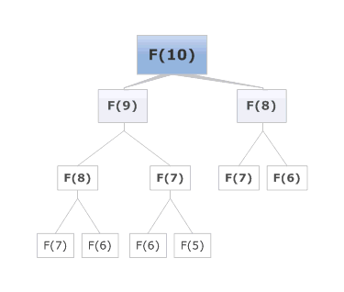
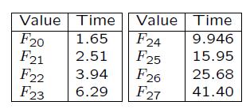
A naive recursive solution
How long will it take to compute
F30, F40 or F50?
Exercise: Show the number of method calls made to fib() is 2F_{n-1}−1.

Slide 10
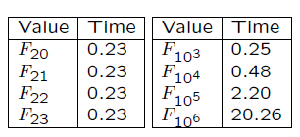
An iterative algorithm
We can easily re-design the algorithm as an iterative algorithm.
int fib(int n) {
int f_2; /* F(i+2) */
int f_1 = 1; /* F(i+1) */
int f_0 = 1; /* F(i) */
for (int i = 1; i < n; i++) {
/* F(i+2) = F(i+1) + F(i) */
f_2 = f_1 + f_0;
/* F(i) = F(i+1); F(i+1) = F(i+2) */
f_0 = f_1;
f_1 = f_2;
}
return f_0;
}

Slide 11



A matrix algorithm
We have the following equation:
Use Mathematical Induction:
Basis: For n=2,
Inductive step: If n=k, the equation holds, then

Slide 12
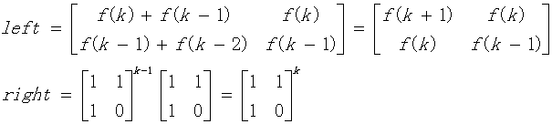

A matrix algorithm
Both sides multiply by [1, 1; 1, 0], we get
Thus, the equation holds for n=k+1.
Use the idea of divide-and-conquer

Slide 13

A little more…
General term formula
Prove it use induction.
Hard to implement.

Slide 14
Evaluating algorithms
Correctness
1. Theoretical correctness
2. Numerical stability
Efficiency
1. Time
2. Space
An algorithm is efficient if it uses as few resources as possible. In many situations there is a trade-off between time and space, in that an algorithm can be made faster if it uses more space or smaller if it takes longer.
Although a thorough analysis of an algorithm should consider both time and space, time is considered more important.

Slide 15
Numerical stability
You can be fairly certain of exact results from a computer program provided all arithmetic is done with the integers
Z = {. . . ,−3,−2,−1, 0, 1, 2, 3, . . .} and you guard carefully about any overflow.
However the situation is entirely different when the problem involves real number, because there is necessarily some round-off error when real numbers are stored in a computer. A floating point representation of a number in base " with precision p is a representation of the form.

Slide 16
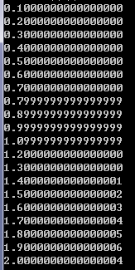
Accumulation of errors
#include <stdio.h>
int main()
{
double t = 0.1;
for (int i = 0; i < 20; i++)
{
printf("%.16lf\n", t);
t += 0.1;
}
return 0;
}

Slide 17
Measuring time
How should we measure the time taken by an algorithm?
We can do it experimentally by measuring the number of seconds it takes for a program to run — this is often called benchmarking and is often seen in popular magazines. This can be useful, but depends on many factors:
The machine on which it is running.
The language in which it is written.
The skill of the programmer.
The instance on which the program is being run, both in terms of size and which particular instance it is.
So it is not an independent measure of the algorithm, but rather a measure of the implementation, the machine and the instance.

Slide 18
Complexity
The complexity of an algorithm is a “device-independent” measure of how much time it consumes. Rather than expressing the time consumed in seconds, we attempt to count how many “elementary operations” the algorithm performs when presented with instances of different sizes.
The result is expressed as a function, giving the number of operations in terms of the size of the instance. This measure is not as precise as a benchmark, but much more useful for answering the kind of questions that commonly arise:
I want to solve a problem twice as big. How long will that take me?
We can afford to buy a machine twice as fast? What size of problem can we solve in the same time?
The answers to questions like this depend on the complexity of the algorithm.

Slide 19
Different instances of the same size
We have assumed that the algorithm takes the same amount of time on every instance of the same size. But this is almost never true, and so we must decide whether to do best case, worst case or average case analysis.
In best case analysis we consider the time taken by the algorithm to be the time it takes on the best input of size n.
In worst case analysis we consider the time taken by the algorithm to be the time it takes on the worst input of size n.
In average case analysis we consider the time taken by the algorithm to be the average of the times taken on inputs of size n.
Notes:
Most often, algorithms are analysed by their worst case running times — the reasons for this are:
• This is the only “safe” analysis that provides a guaranteed upper bound on the time taken by the algorithm.
• Average case analysis requires making some assumptions about the probability distribution of the inputs.
• Average case analysis is much harder to do.

Slide 20
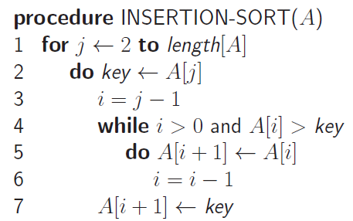
An example - Insertion sort
Lines 2-7 will be executed n times, lines 4-5 will be executed up to j times for j=1 to n.

Slide 21
Asymptotic notations
Big-O notation: It defines an asymptotic upper bound for a function f(n).
Definition: A function f(n) is said to be O(g(n)) if there are constants c and n₀ such that
f(n) ≤ cg(n), ∀ n ≥ n₀.
Big-Omega notation (Ω): It defines an asymptotic lower bound for a function f(n).
Big-Theta notation: It defines an asymptotic upper and lower bound for a function f(n).
Definition: A function f(n) is said to be Θ(g(n)) if there are constants c₁, c₂ and n₀ such that
0 ≤ c₁g(n) ≤ f(n) ≤ c₂g(n), ∀ n ≥ n₀.
If we say that f(n) = Θ(n²) then we are implying that f(n) is approximately proportional to n² for large values of n.

Slide 22
Asymptotic notations
There exist positive constants c
such that there is a positive constant n₀
such that …
cg(n)
f(n)
There exist positive constants c₁ and c₂
such that there is a positive constant n₀
such that …
c₂g(n)
f(n)
n
c₁g(n)
n₀
f(n) = O( g(n))
There exist positive constants c
such that there is a positive constant n₀
such that …
f(n)
n
n₀
f(n) = Θ( g(n))
cg(n)
n₀
n
f(n) = Ω( g(n))

Slide 23
Order of growth
Asymptotic notations: Θ, O, Ω, o, ω.
The constant coefficient(s) are ignored.
Lower order item(s) are ignored, just keep the highest order item.
The rate of growth, or the order of growth, possesses the highest significance.
The insertion sort runs in Θ(n²).
f(n)= Θ(g(n)) actually means：f(n) ∈ Θ(g(n))。
Typical order of growth: O(1), O(log n), O(√n), O(n), O(nlog n), O(n²), O(n³), O(2^{n}), O(n!).
What’s the complexity of each Fib algorithm?

Slide 24
Approximation for factorials
Stirling’s approximation

Slide 25
Arithmetic operation
O(f(n))+O(g(n)) = O(max{f(n),g(n)}) ；
O(f(n))+O(g(n)) = O(f(n)+g(n)) ；
O(f(n))*O(g(n)) = O(f(n)*g(n)) ；
O(cf(n)) = O(f(n)) ；
g(n)= O(f(n)) ⇒ O(f(n))+O(g(n)) = O(f(n)) 。

Slide 26
Order of growth
2^{n}
n²
n log n
f
n
log n
n

Slide 27
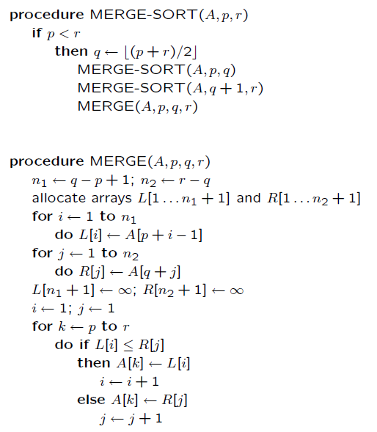
An asymptotically better sorting algorithm: Merge-sort

Slide 28
Analysis of the Merge-sort algorithm
Described by recursive equation
Suppose T(n) is the running time on a problem of size n.
T(n) = Θ(1) if n≤n_{c}
aT(n/b)+D(n)+C(n) if n> n_{c}
where a: number of subproblems
n/b: size of each subproblem
D(n): cost of divide operation
C(n): cost of combination operation

Slide 29
Analysis of the Merge-sort algorithm
Divide: D(n) = Θ(1)
Conquer: a=2,b=2, so 2T(n/2)
Combine: C(n) = Θ(n)
T(n) = Θ(1) if n=1
2T(n/2)+ Θ(n) if n>1
T(n) = c if n=1
2T(n/2)+ cn if n>1

Slide 30
Analysis of the Merge-sort algorithm
The recursive equation can be solved by recursive tree.
T(n) = 2T(n/2)+ cn,
lg n+1 levels, cn at each level, thus
Total cost for merge sort is:
T(n) =cnlg n +cn = Θ(nlg n).
Question: best, worst, average?

Slide 31
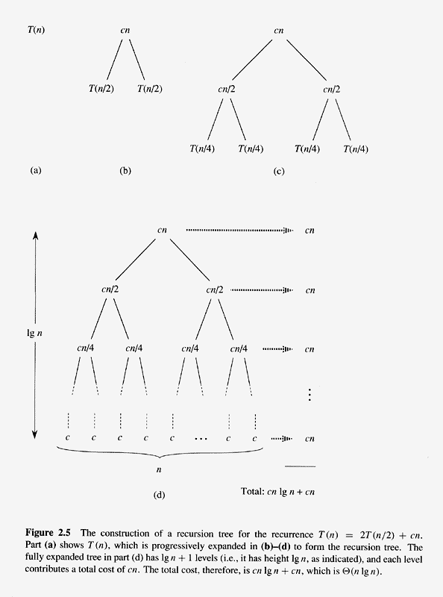
Analysis of the Merge-sort algorithm

Slide 32
Homework
1. Prove that
2. Prove that f(n)=an²+bn+c=Θ(n²).
3. Prove that O(f(n))+O(g(n)) = O(max{f(n),g(n)}).
4. Calculate fib(n) mod p, where p is a prime. Submit your code on Sicily platform.

Slide 33
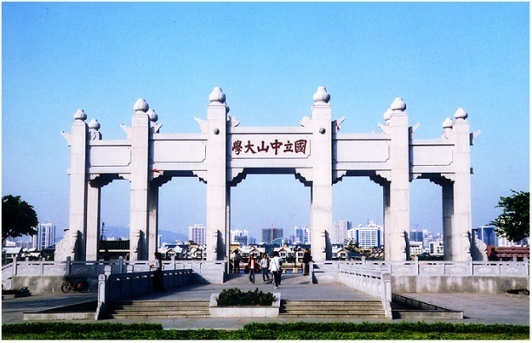
Thank you!

